Slide 1

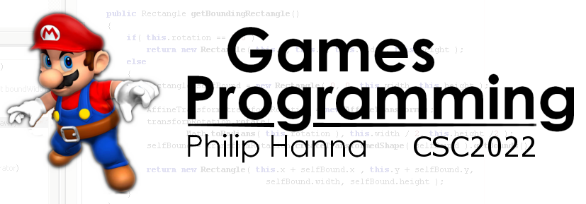
UX Design
Designing with the user’s experience in mind.
Part 4 – Not seeing

Slide 2

Not seeing the whole picture

Slide 3
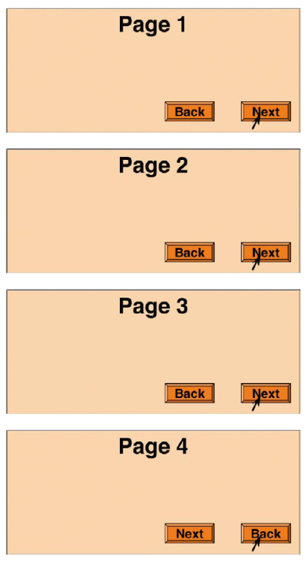
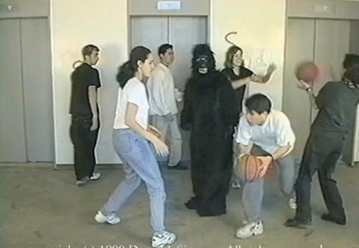
What we see is, in part, based on what we expect to see.
Aside: Seeing, in this context, entails a degree of conscious awareness.

Slide 4

Our past experience and the present context bias what we perceive. Additionally, our perception if influenced by our future goals.
Our experience, context and goals act to filter what we perceive. Unrelated aspects tend to be filtered and not consciously perceived.

Slide 5
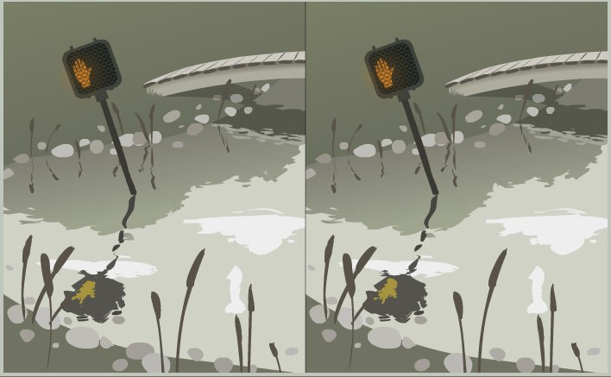
Do not assume that a change (provided information, control change) will be noticed by the user. Firstly ask ‘why’ and then ‘how’ will the user notice this.
Your interfaces should be always be consistent and predictable.

Slide 6

Avoid Ambiguity
Build your design around standards and conventions. Ideally those which are well established.
Verify that users will interpret the design in the same way.

Slide 7

Be Consistent
Interface elements that serve the same function on different screens should be placed in the same position on each screen and use the same font, layout, etc.
Doing so will help the user quickly recognise or locate information and controls.

Slide 8

Understand the user’s goals
Ask what is the user likely wanting to accomplish at this point in the application.
From this, provide whatever information and/or functionality the user is likely to need.
This need-driven process should be at the heart of your interface design.

Slide 9

Our Colour Vision is Limited

Slide 10
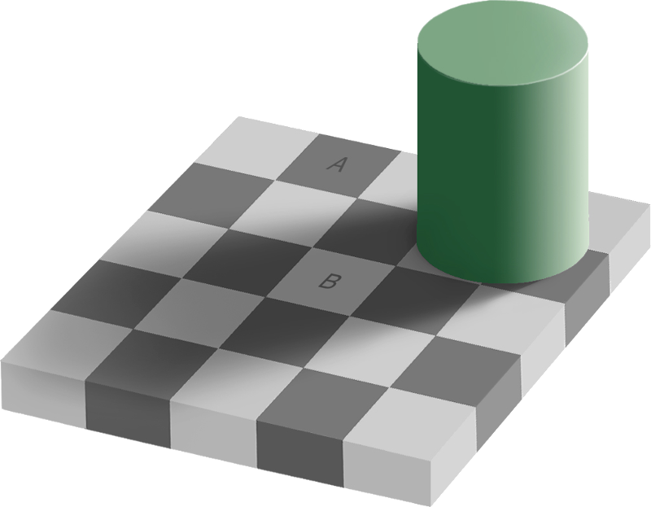
Our eyesight is much more sensitive to differences in colour and brightness (used to detect edges). It is relatively insensitive to the absolute colour/brightness.
For example, we perceive A and B as different colours, even thought they are identical in colour.

Slide 11
Certain colours don’t go well together. Avoid blue or green text on a red background, and red or green text on a blue background. These colour combinations can be hard to read.
Aside: Chromostereopsis is a visual illusion where depth is conveyed from colours (one colour may jump out or another appear recessed).

Slide 12

Getting Noticed

Slide 13
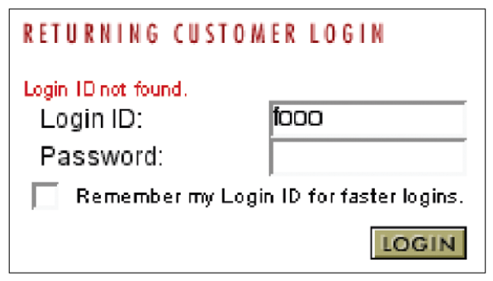
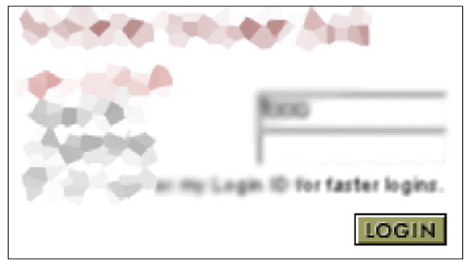
Displaying an error message here may not be noticed if the user has just clicked on the login button.
Our peripheral vision is not great. Stationary item introduced into the periphery of the user’s vision will often not be noticed. However, motion (wiggle, blinking) is typically noticed in the periphery.

Slide 14
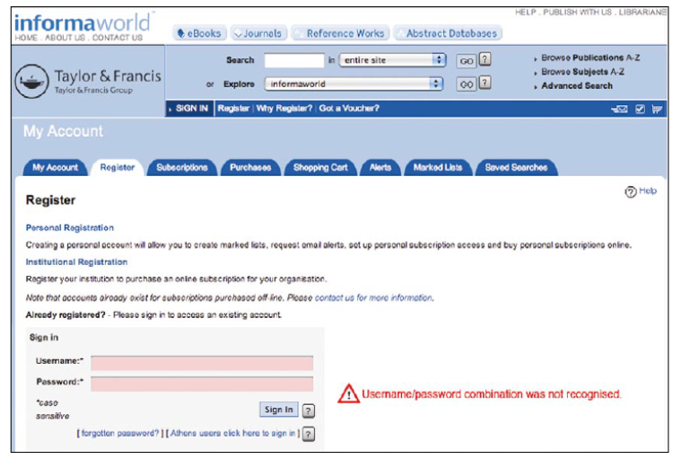
To make new information visible:
Put it where the user is likely to be looking: When the user clicks a button or link, they can usually be assumed to be looking at it.
Use an error symbol: Make errors or error messages more visible by marking them with an error symbol
Reserve a bright colour for errors: By convention, red signifies alerts, errors, etc.

Slide 15

Heavy Artillery (Use Sparingly)
Use a modal dialog: Dialogues interrupt the user and demand immediate attention.
Play a distinct alert sound: A beep tells the user something important has happened and will likely trigger a visual search.
Briefly flash or wiggle: Motion in our periphery can cause reflective eye movement to brings the motion into focus.

Slide 16

Key takeaways:
What we see is, in part, based on what we expect to see. We often ignore anything else.
Changes in the periphery of our vision may be missed. The periphery can cover a large part of the screen.
We should try to understand the goals of the user; what they expect to see; and where they are likely to looking.

